Slide 1


Remix
and
Solidity
Demo
Team Emerging Technologies
[Date]

Slide 2



Contents:
Remix
and
Solidity
Demo
Solidity contract
Compiler configuration
Deploy configuration
MetaMask connections
Deploy testing
By:

Slide 3
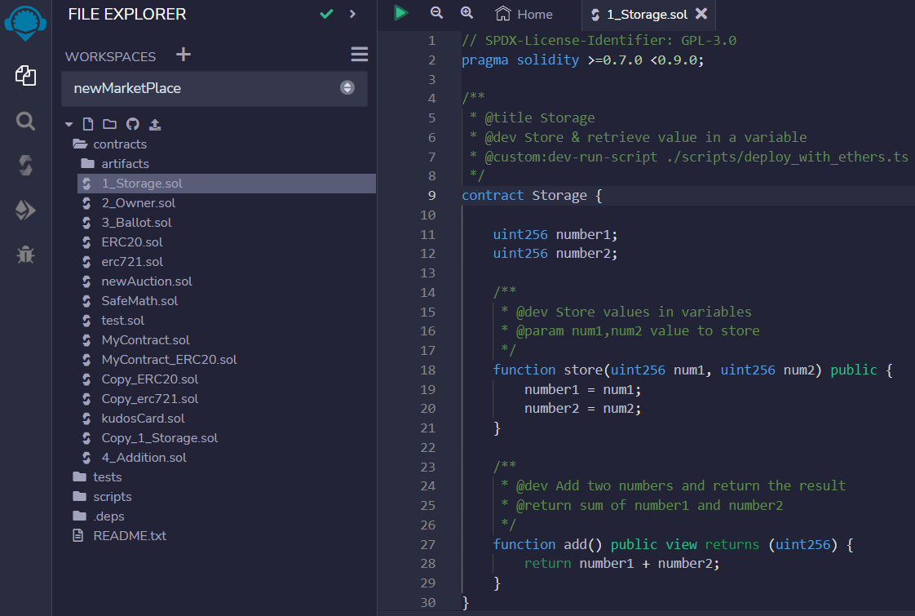
Solidity Contract
Select SPDX License
Write Compiler Version
Write Contract Class
Initiate variables
‘Store’ and ‘Add’ Functions

Slide 4
Link for Smart Contract Code
https://github.com/BilalWarraich/integrate-smart-contract-metamask-ui/blob/main/1_Storage.sol

Slide 5
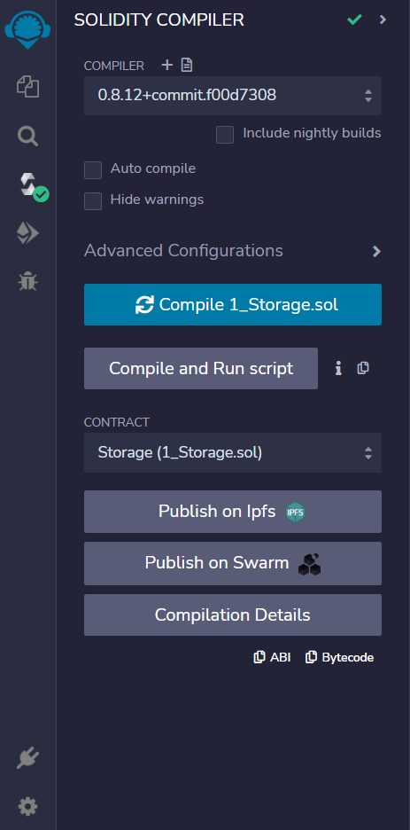
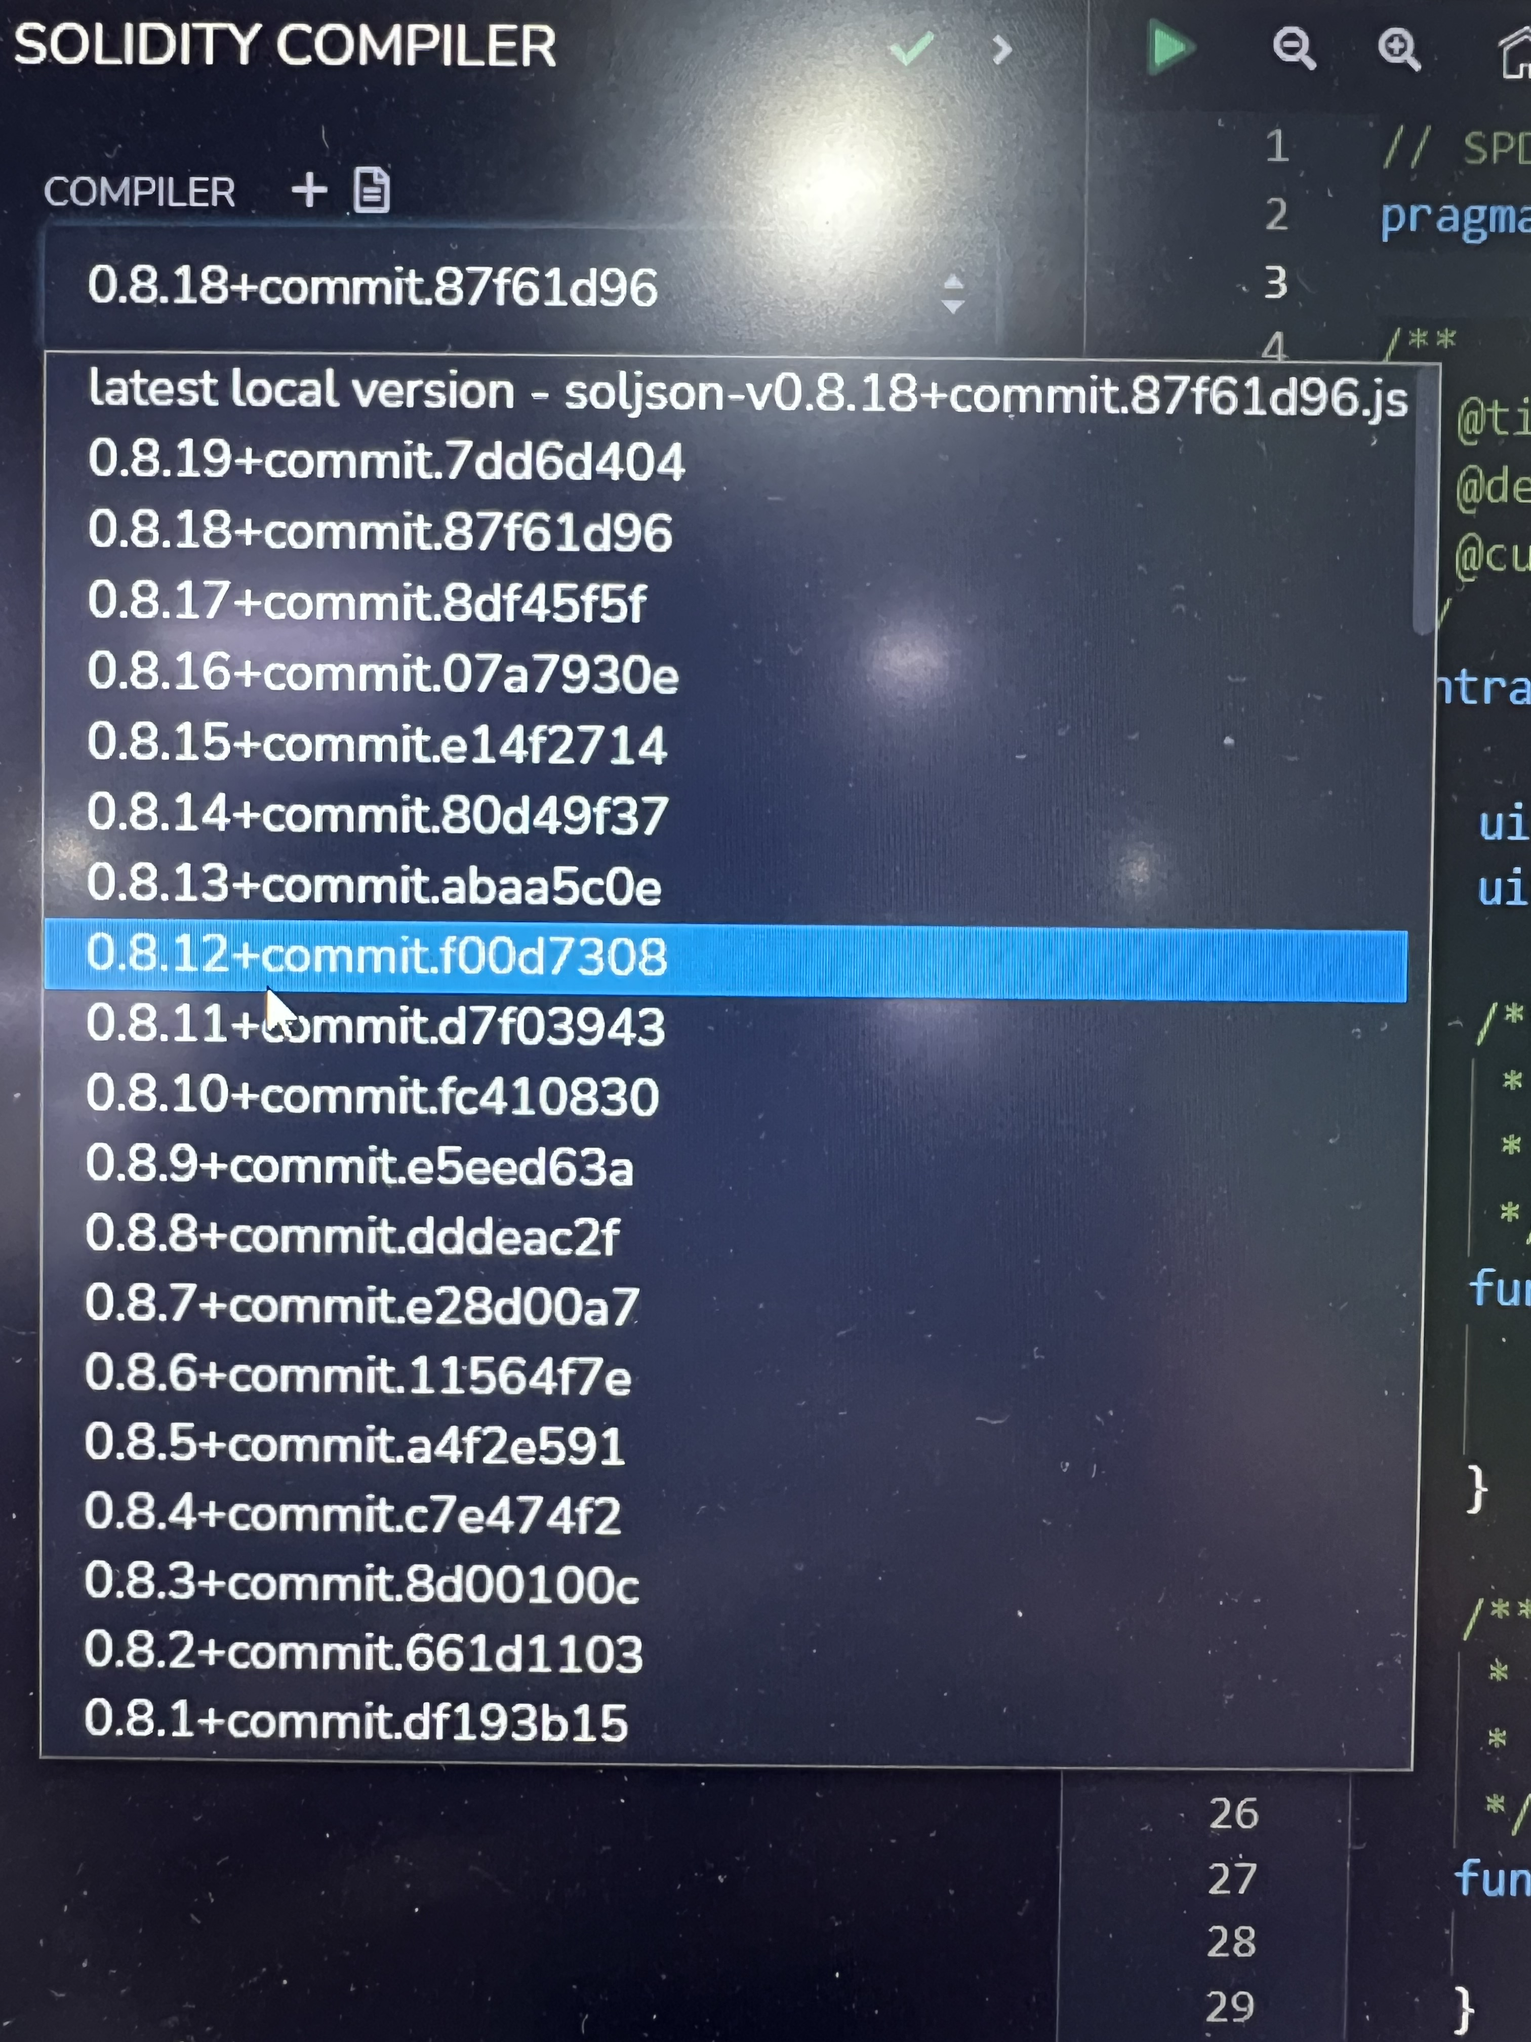
Compiler Configuration
Select Compiler
Version from dropdown
Select Compile from sidebar
Click on compile
The Contract Application Binary Interface (ABI) is the standard way to interact with contracts from web Apps or other contracts.
ABI can be copied from here later to be used in react app.

Slide 6
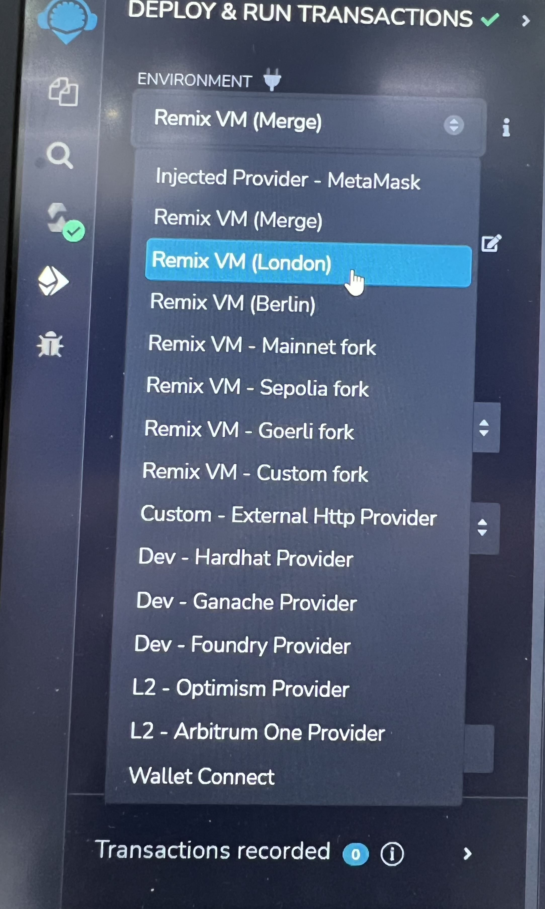
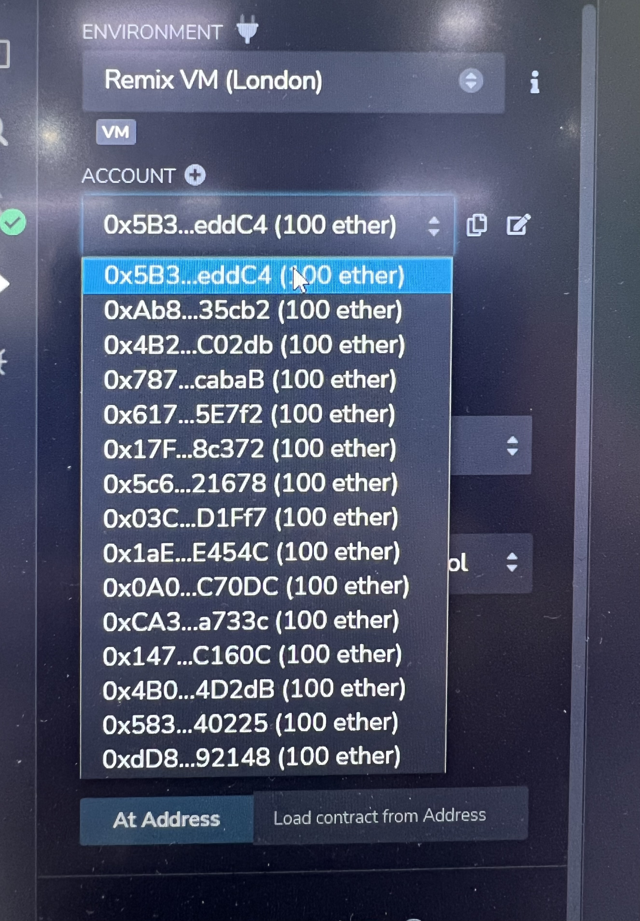
Deploy Configuration
To Connect with Metamask select injected provider- metamask
Select required account from dropdown
Go to Deploy option from sidebar
Select desired environment from dropdown

Slide 7
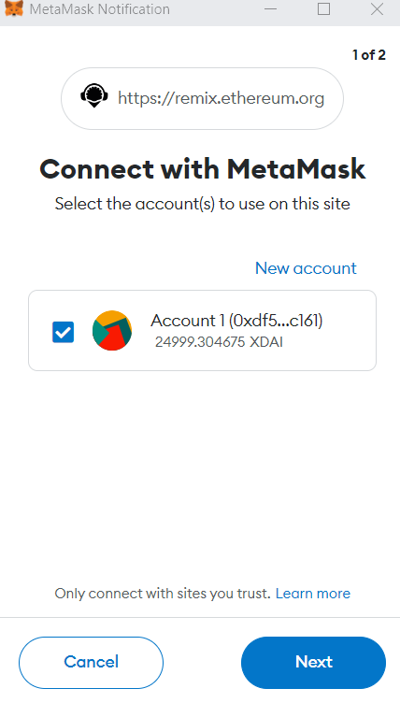
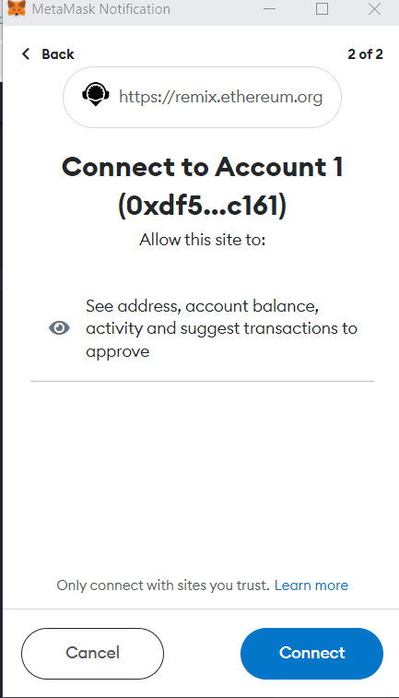
Connect Account on Metamask
After selecting account on remix,
Metamask web configuration screen will pop up. Connect your account in it.

Slide 8
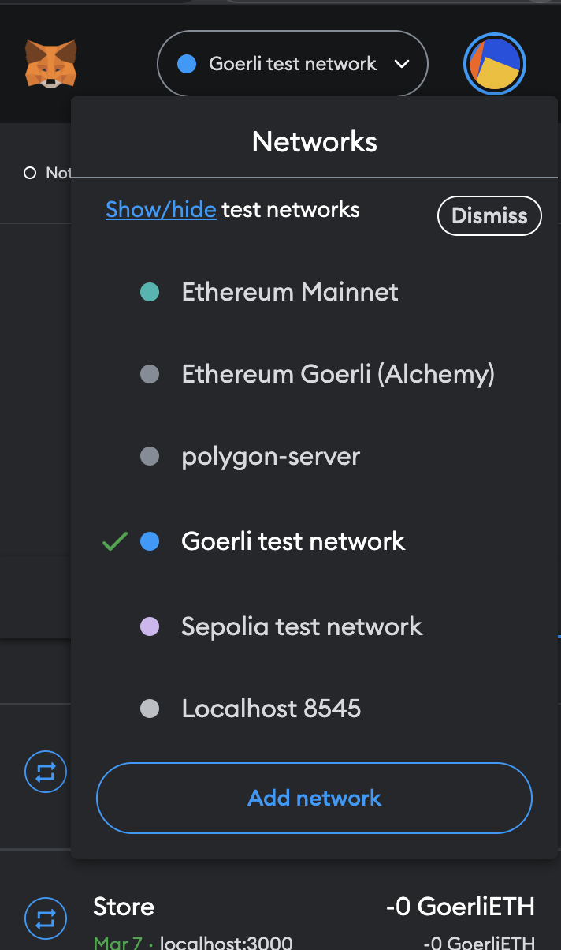
Switch to testnet on metamask
Switch to goerli testnet on metamask which is the commonly used testnet on metamask. Or you can switch to local host but for that you need to have a local blockchain node setup either through ganache or hardhat but this topic is a discussion for some other day.

Slide 9
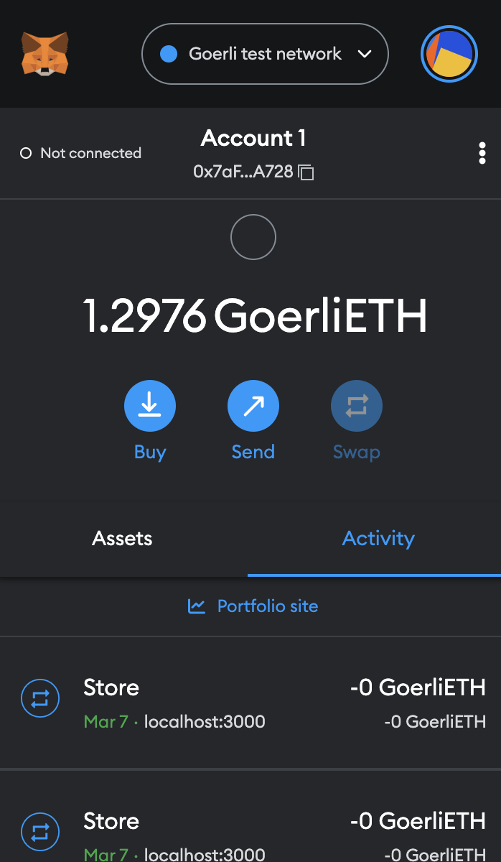
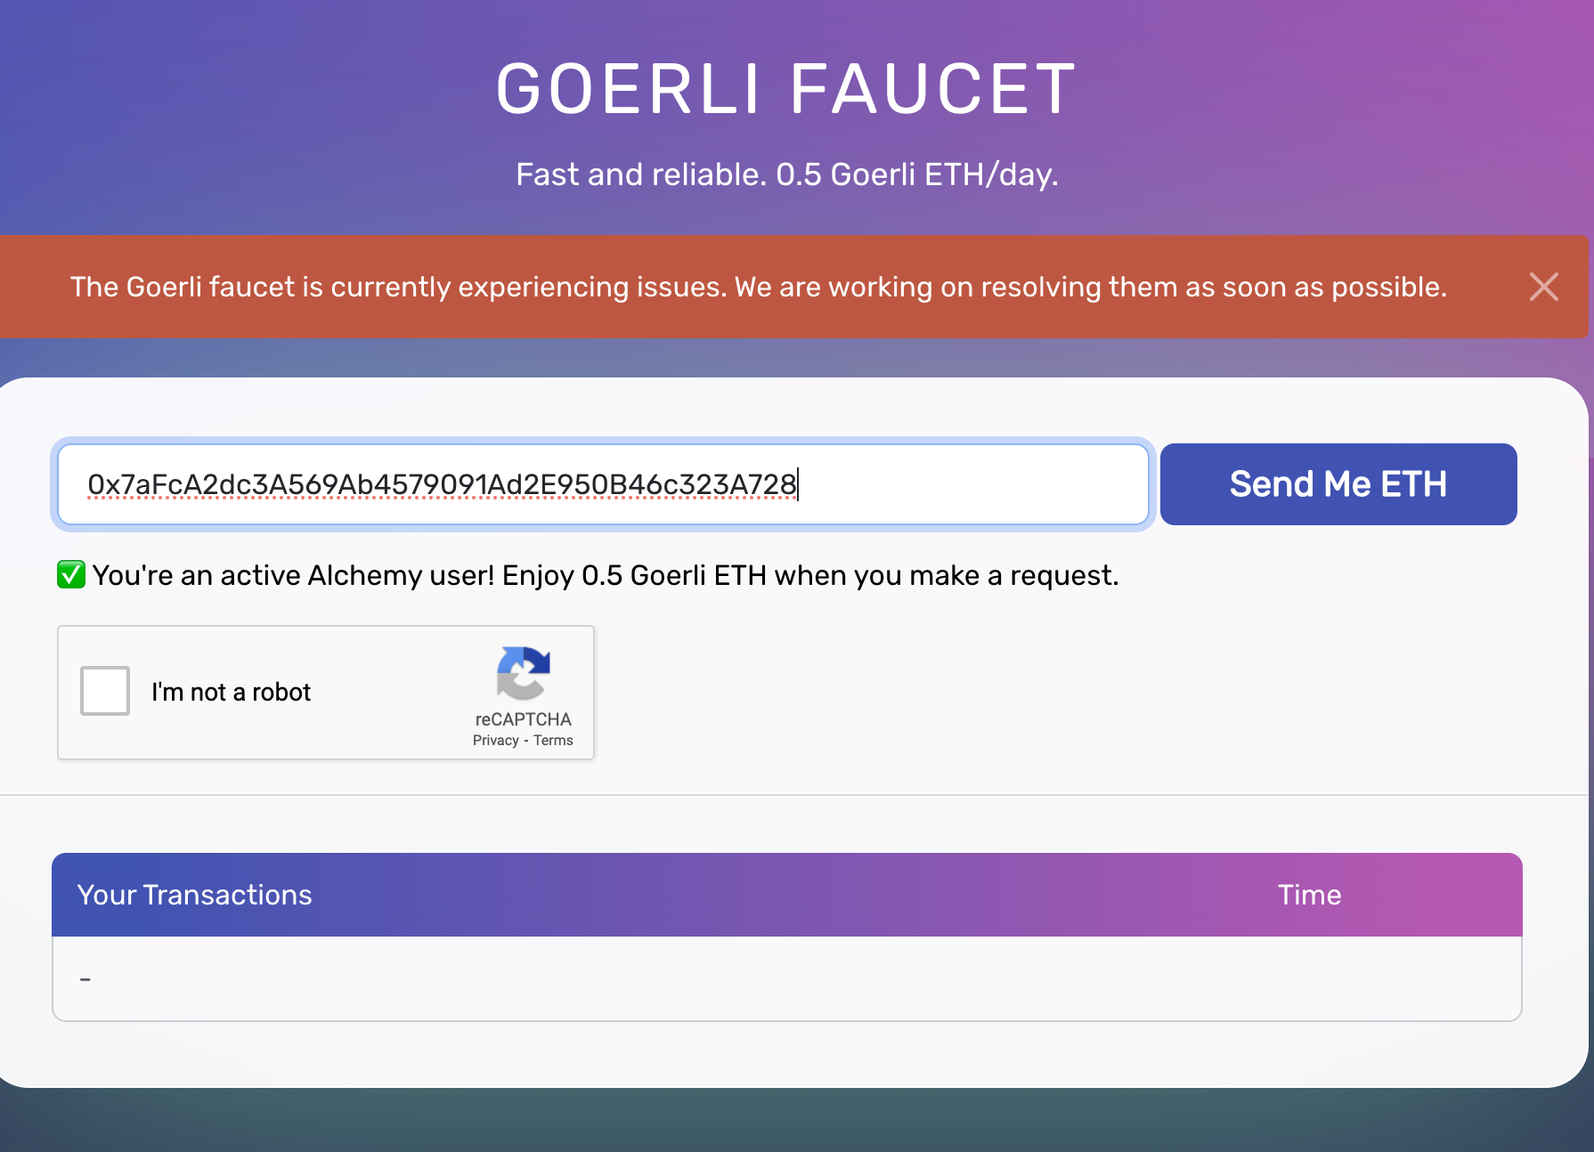
Add Ethers to your testnet
Copy the account Address from metamask.
Search "Goerli Faucet" on browser and it will give you some websites from where you can get test ethers for your account after pasting your account address.

Slide 10
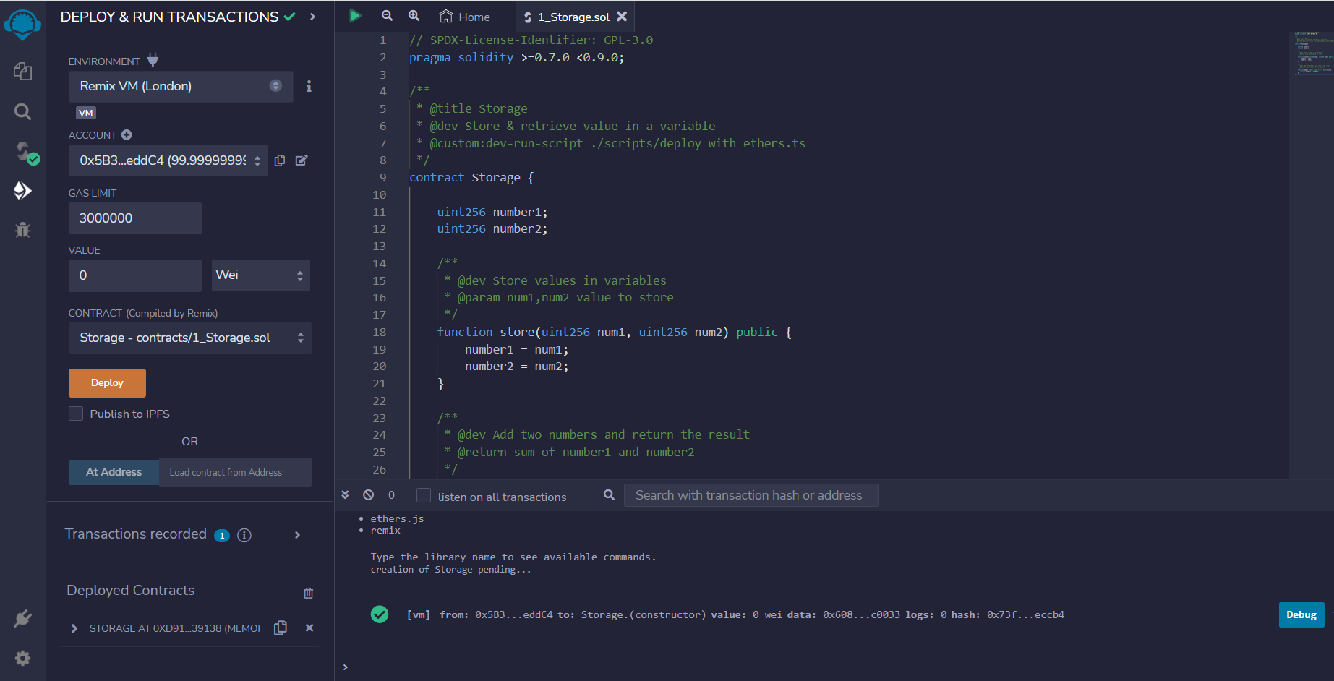
Deploy Configuration
Click on Deploy
Contract Address can be copied from here to be used later in react app or to access contract from outside remix
Deploy Confirmation

Slide 11
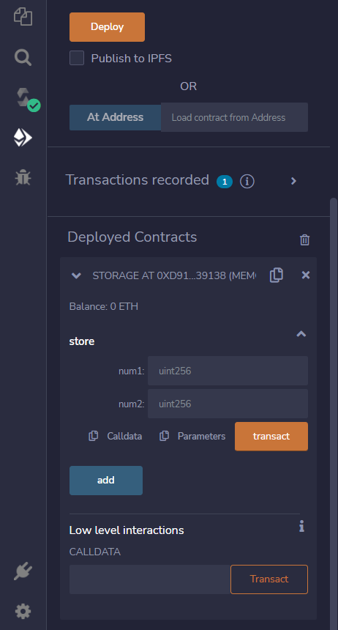
Deploy Testing
After Deploying contract on remix,
You can see functions (store and add) inside deployed contract.
Function 1
Function 2

Slide 12
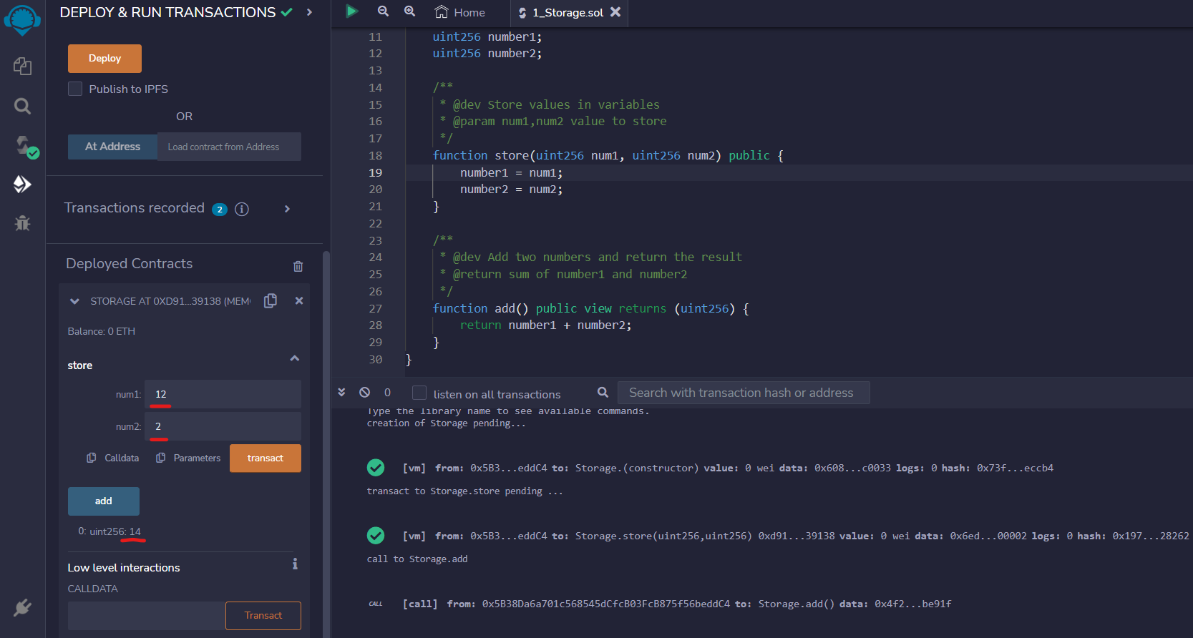
Deploy Testing
Add values and Run transaction
Running add function will give you result
Confirmations of functions runs

Slide 13
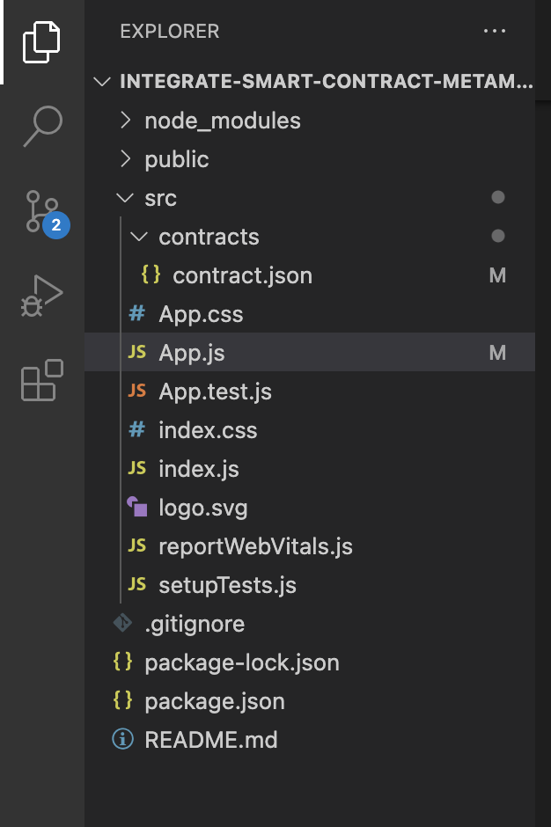
Connecting with React App
Create a basic react app to connect with metamask and you contract either deployed on testnet or deployed locally. We need to copy our contract ABI from remix which we received at the time of compilation in our contract.json file.
Or you can clone the repository by running the following command in your terminal git clone https://github.com/BilalWarraich/integrate-smart-contract-metamask-ui.git Afterwards you need to execute the following command in the terminal inside the project repo to install all the binaries: npm install

Slide 14
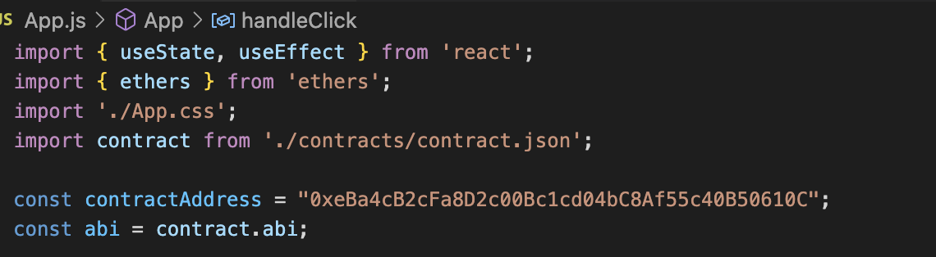
Connecting with React App
We need to input our contract address and contract ABI both of which we can get from the remix IDE like shown above.

Slide 15
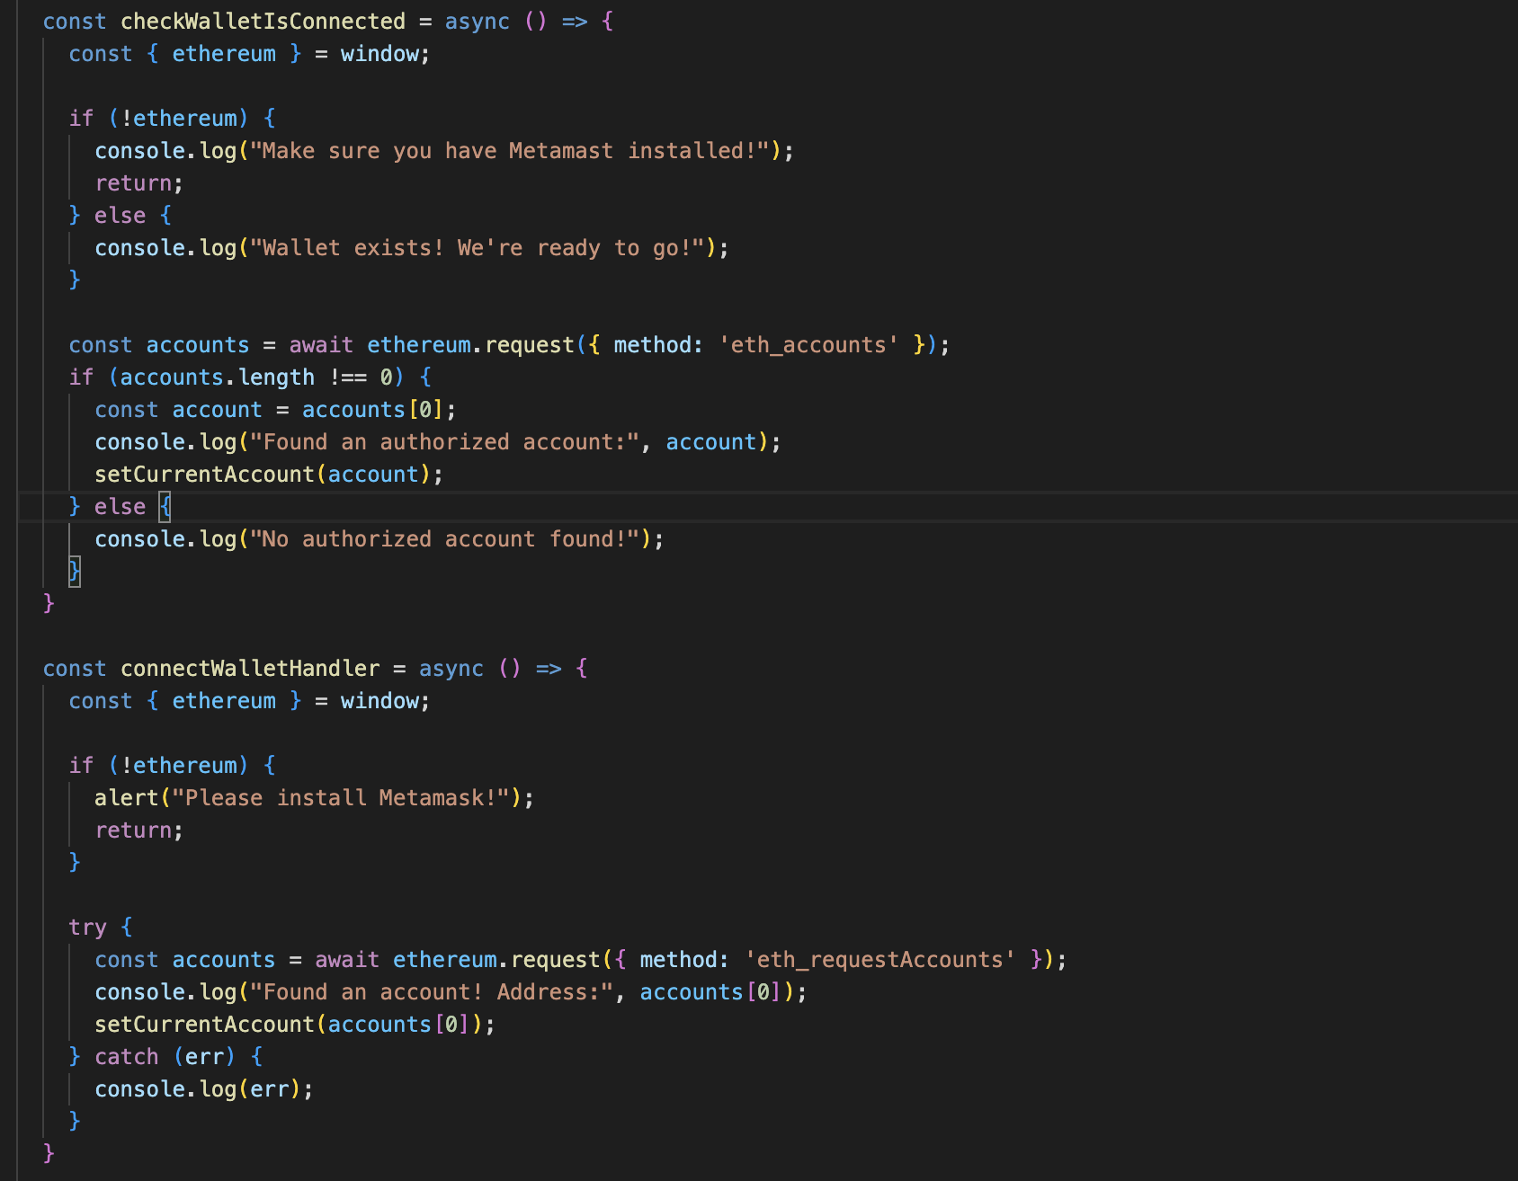
Connecting with React App
The methods shown are for wallet connection. First one checks if the wallet is connected and second one connects the wallet if it is not connected. To achieve this Ether.js library is used which will make a request to the web provider available and prompt to install if there is none. It will connect with whatever network is running on the wallet in our case Goerli Testnet. We are using metamask as our webprovider and it needs to have its extension installed on the browser.

Slide 16
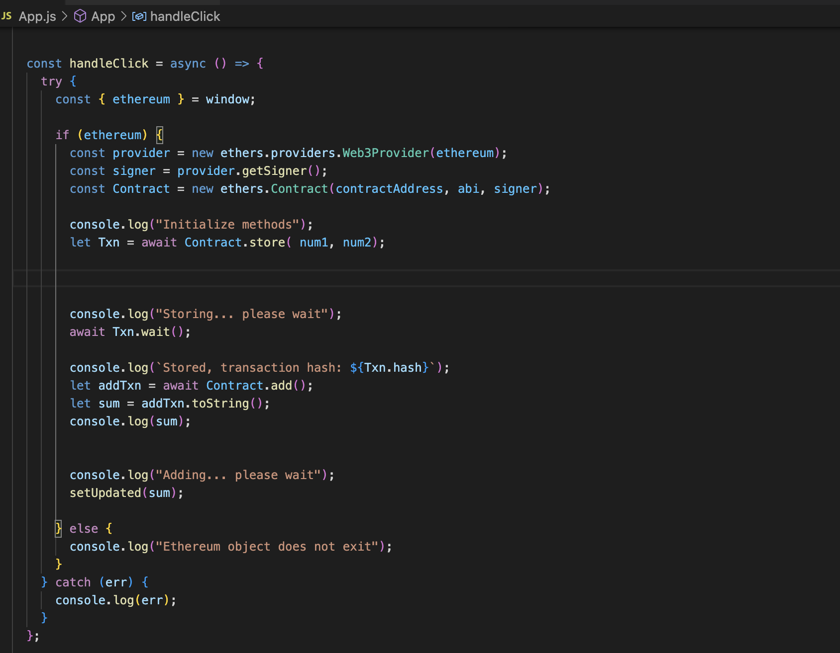
Connecting with React App
Here again using the Ether.js library to connect with our contract through its address and ABI The handler shown sends requests to one of the method of the smart contract.

Slide 17
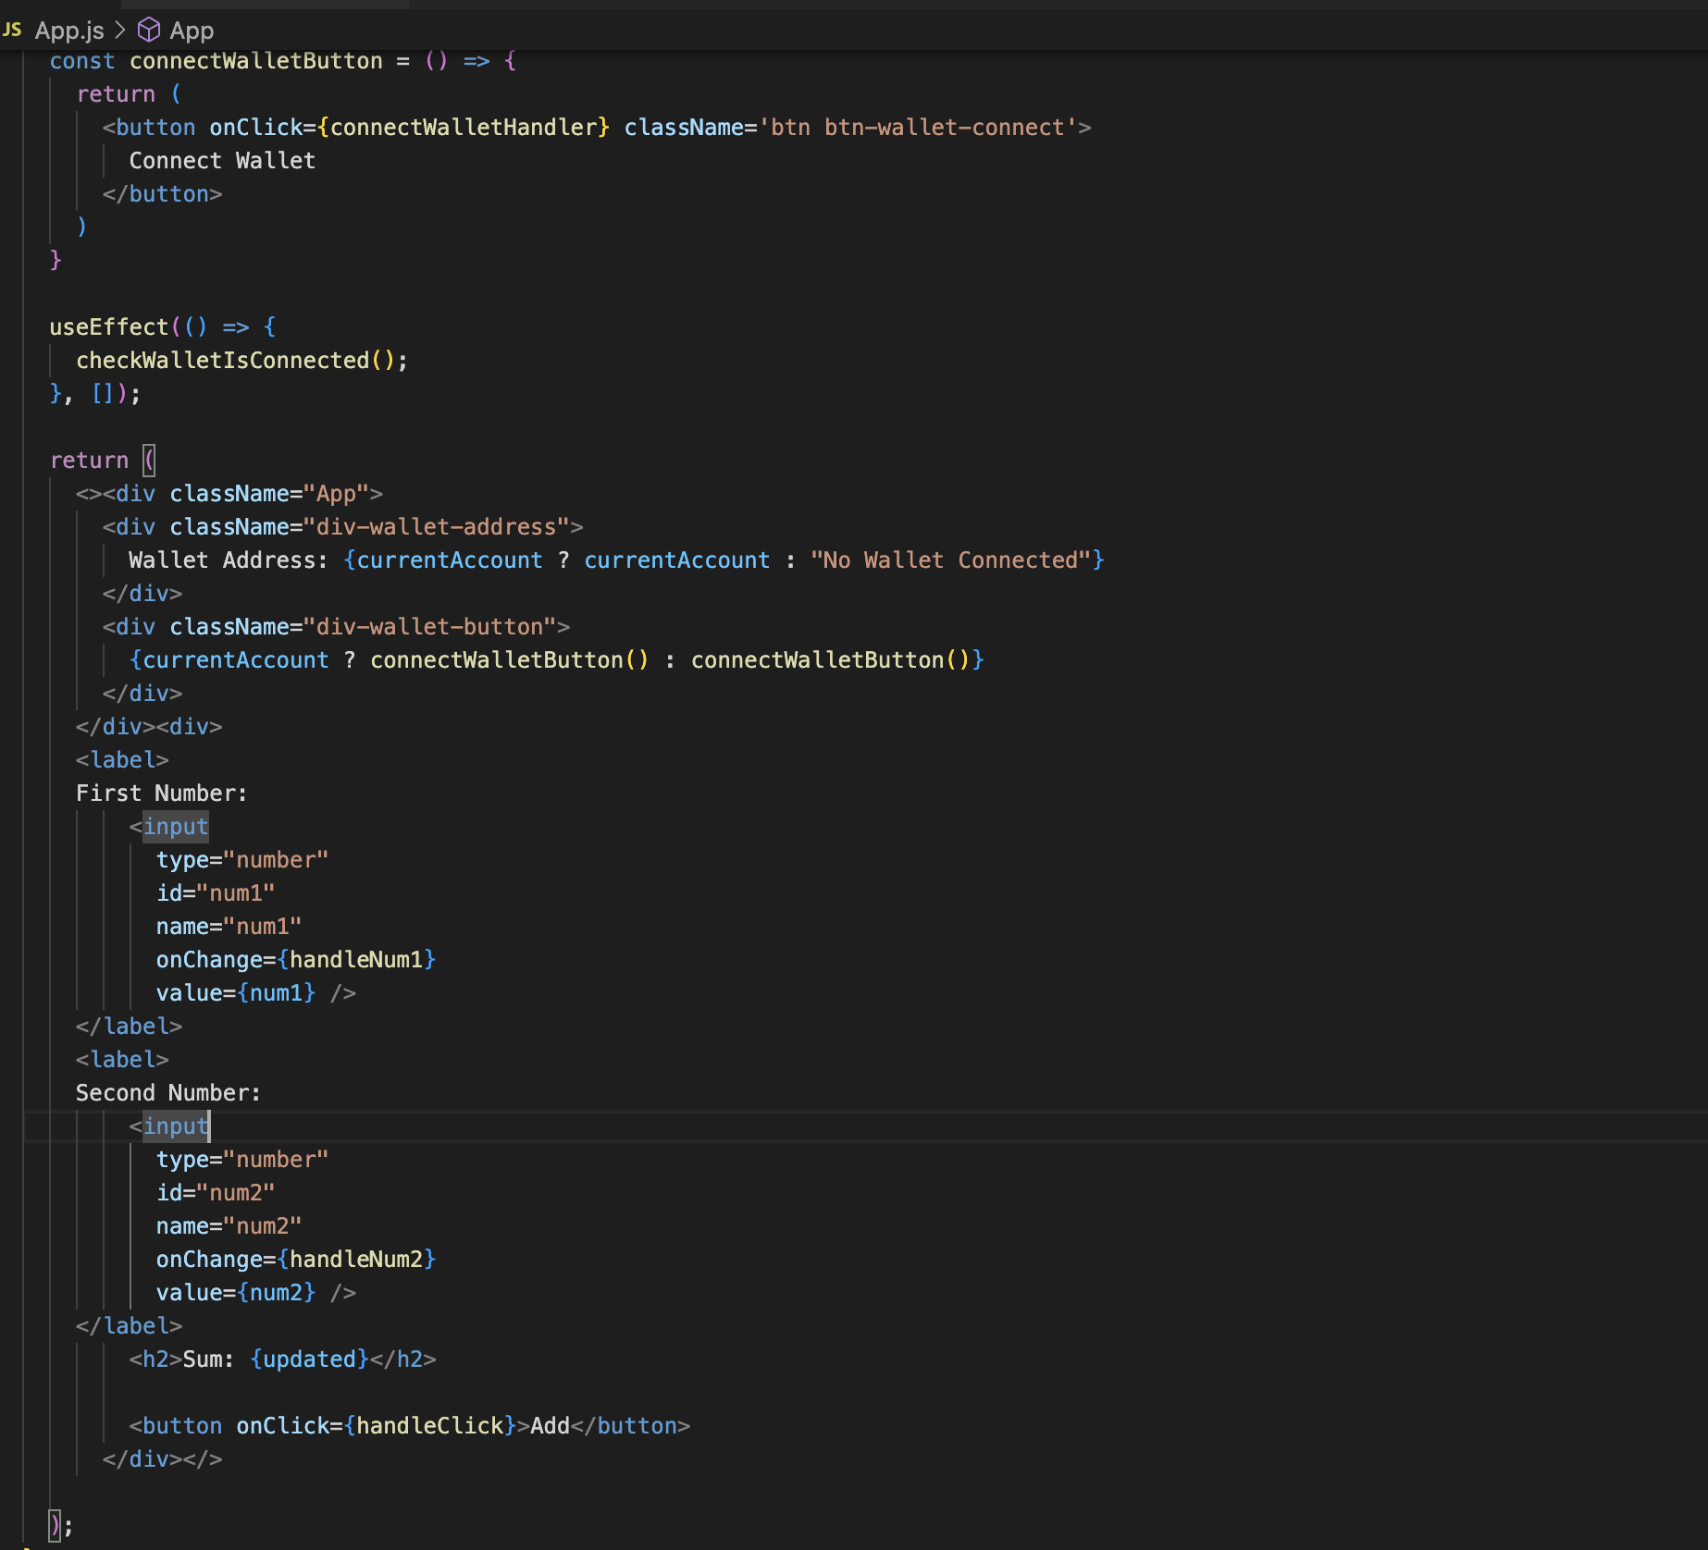
Connecting with React App
This part shows all the text boxes and buttons and what happens if we making any changes in them.

Slide 18
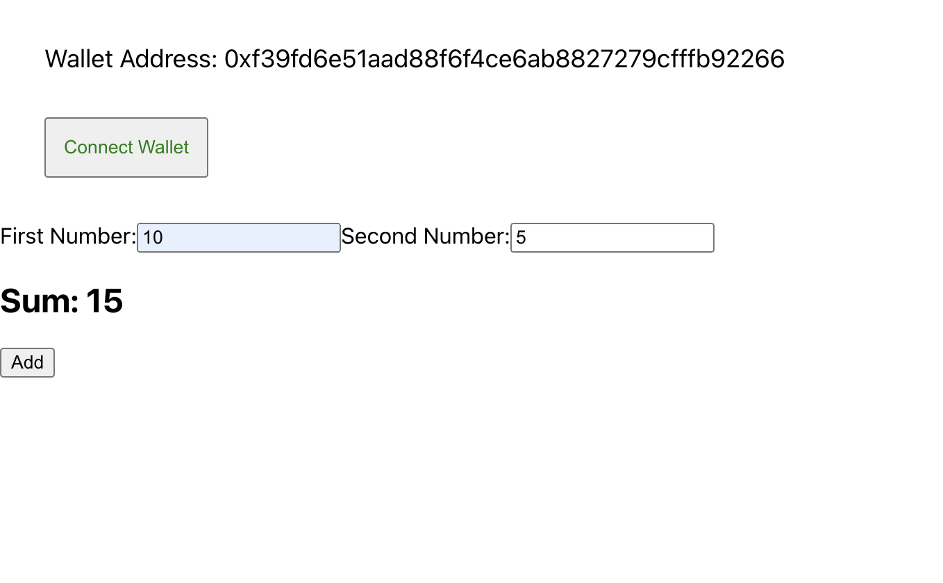
Connecting with React App
To start the app we need to execute npm start from the terminal inside the project directory. Our app will be running on localhost:3000 afterwards. It’s a simple interface with connect wallet button and textboxes for executing the smart contract methods.

Slide 19
Thanks

Slide 20

Headquarters
4 Cedarbrook Drive, Bldg. B
Cranbury, NJ 08512
Tel: 609 452 0700
Fax: 609 655 5232
Pittsburgh
183 Industry Drive
Pittsburgh, PA 15275
Tel: 412 927 0226
Fax: 412 265 4182
Asia
Bangalore, India
Coimbatore, India
Karachi, Pakistan
Lahore, Pakistan
Islamabad, Pakistan
New York
27 W. 24th Street, #1108 New York, NY 10010
Tel: 347 966 5336
Fax: 609 655 5232
Australia
Sydney, New South Wales
Canada
Toronto, Ontario
Europe
Munich, Germany
Stuttgart, Germany
Middle East
Dubai, UAE
Doha, Qatar

